Slide 1

TITLE : “Design and Implement DFT magnitude spectrum based gender discrimination by finding dominant frequency peaks. Assume sampling rate of 16000 Hz for recording speech sounds of male and female and suitable block duration “
DIGITAL SIGNAL PROCESSING LAB (EC-16201)
Btech 6TH semester
SUBMITTED By :
Himanshu Gupta (Reg. No. 20211078)
Divyanshi Kesarwani (Reg. No. 20215110)
Jyoti Chaurasia (Reg. No. 20215062)
Mehul Garg (Reg. No. 20215134)
SUBMITTED to :
Dr. Dharmendra Dixit
Dr. Nilesh Kumar Yadav
Department of Electronics and Communication Engineering
MOTILAL NEHRU NATIONAL INSTITUTE OF TECHNOLOGY
ALLAHABAD-211004, INDIA
SESSION:2024

Slide 2
PROBLEM STATEMENT
“Design and Implement DFT magnitude spectrum based gender discrimination by finding dominant frequency peaks. Assume sampling rate of 16000 Hz for recording speech sounds of male and female and suitable block duration “.

Slide 3
MOTIVATION
Research Interest: Gender recognition using voice is an active area of research in fields such as signal processing, machine learning, and gender studies.
Social Impact: Understanding the differences in voice characteristics between genders can have implications for various social issues, including gender equality, identity recognition. By studying and developing gender recognition systems, researchers may contribute to raising awareness and addressing these issues.
Technological Advancements: With advancements in signal processing and machine learning techniques, researchers may be motivated to explore how these technologies can be applied to gender recognition tasks. Developing efficient and accurate gender recognition algorithms can showcase the capabilities of these advancements.
Educational Purposes: The motivation behind the project likely involves a combination of academic interest, practical applications, social impact, technological advancements, and educational objectives

Slide 4
THEORY
The voice of male falls in the average frequency range of 85 to 155 Hz whereas the voice of a female ranges from 165 to 255 Hz . This factor will be used to differentiate and decide the gender on the basis of voice recognition .

Slide 5
DFT MAGNITUDE SPECTRUM
To perform frequency analysis on a discrete-time signal {x[n]} , we convert the time – domain sequence to an equivalent frequency- domain representation . Unlike DTFT , DFT is finite in magnitude as it takes N points and do the processing , We will do the frequency analysis on the magnitude response .

Slide 6
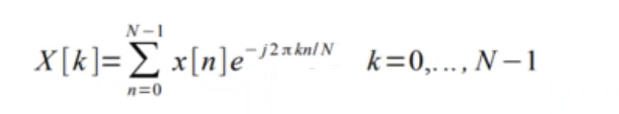
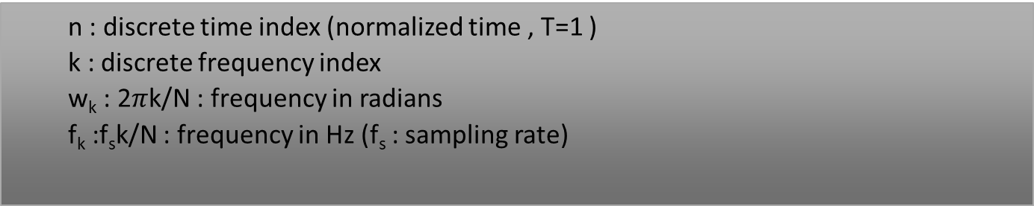
DFT FORMULAE
n : discrete time index (normalized time , T=1 )
k : discrete frequency index
w_{k} : 2$π$k/N : frequency in radians
f_{k} :f_{s}k/N : frequency in Hz (f_{s} : sampling rate)

Slide 7
PROCEDURE
TASK 1: Recording audio on the spot at the sample rate of 16000 Hz for a duration of 10 seconds using the ‘audiorecorder’ object .
TASK 2: After applying the DFT , the N-point single sided amplitude spectrum is plotted where the graph of X(f) versus f is shown .
Now , we will select the pitch of sound by finding the dominant frequency . It will be noted that we will find the location of frequency at which maximum peak occurs till only 260 Hz since that is the range of average human speech signals for identification and display the results .
There will be few error in the overlapping region(transition region) of 155-165 Hz as well as we will not be able to identify clearly whether it is male or female .

Slide 8
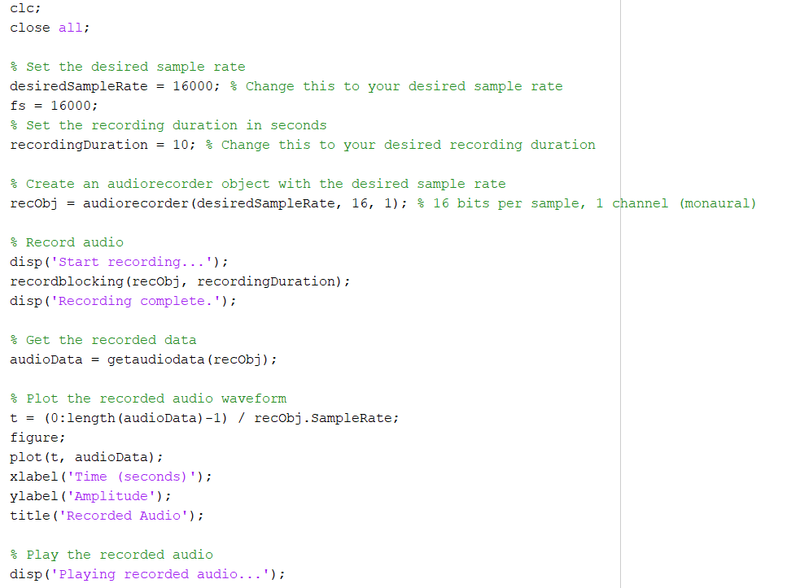
SOURCE CODE

Slide 9
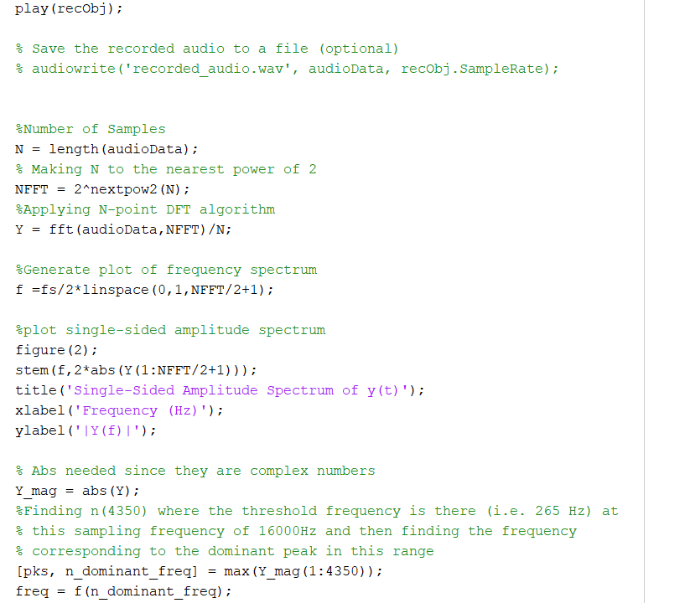
SOURCE CODE Cont.

Slide 10
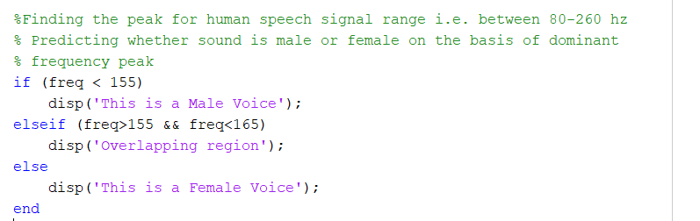
SOURCE CODE Cont.

Slide 11
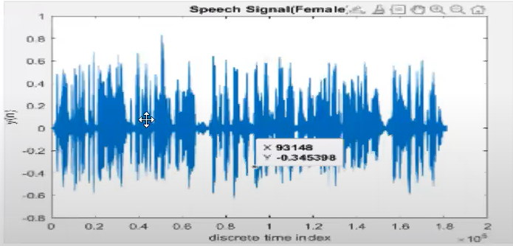
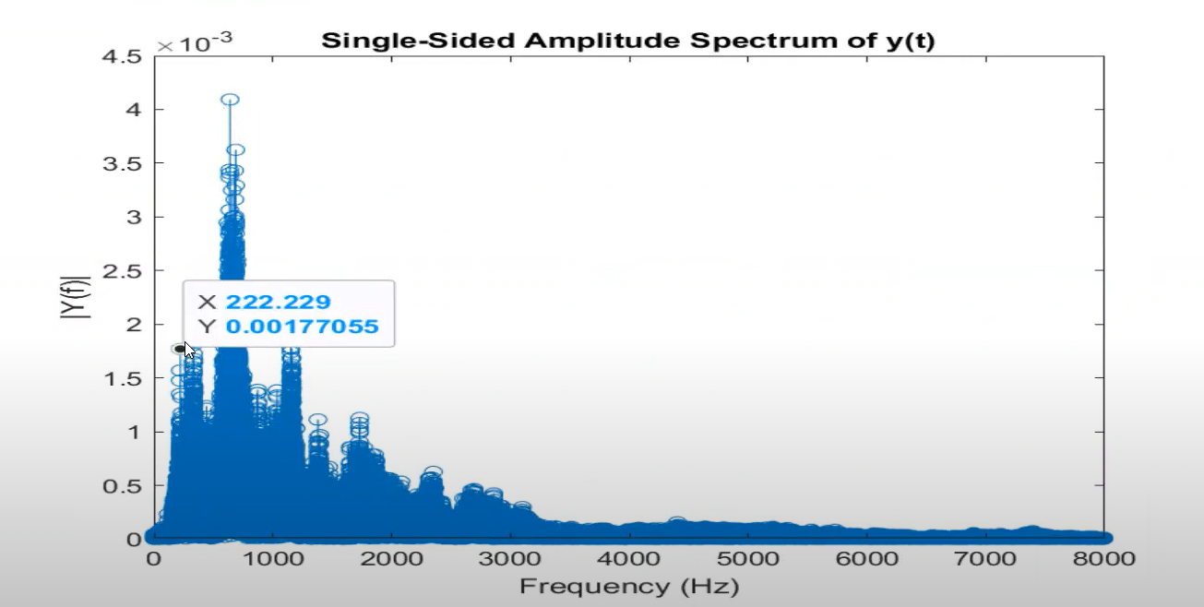
Female output waveform
Fig 1 : Time Domain Representation Fig 2 : Frequency Domain Representation

Slide 12
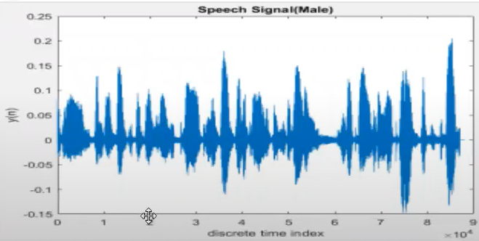
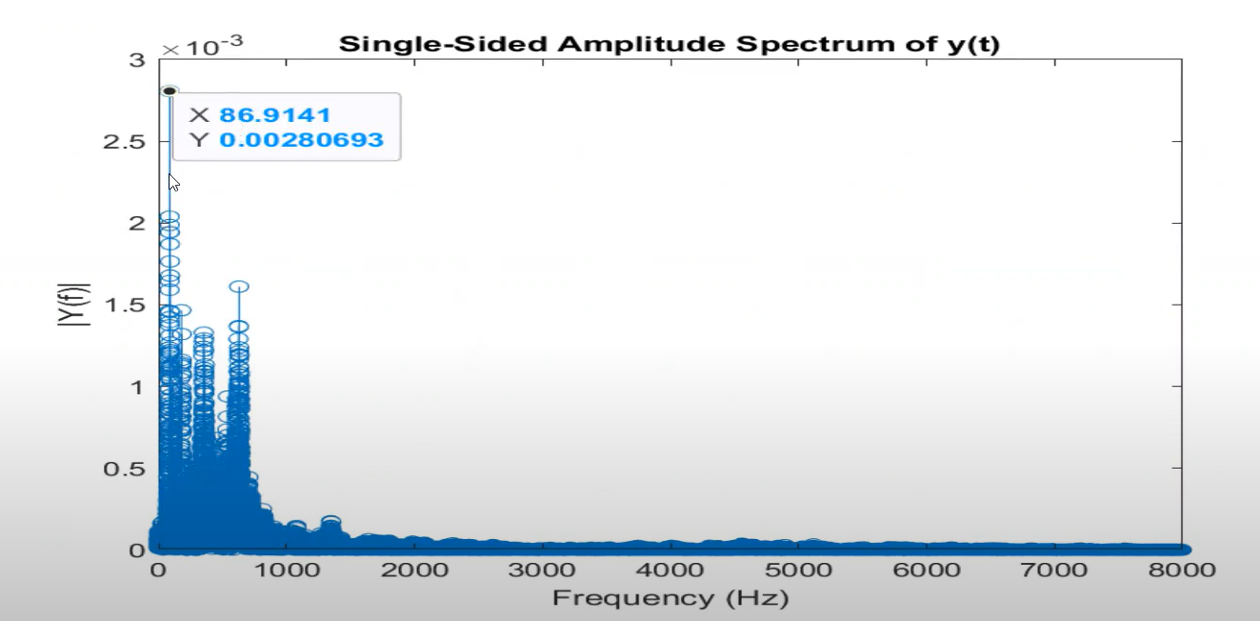
male output waveform
Fig 3 : Time Domain Representation Fig 4 : Frequency Domain Representation

Slide 13
OBSERVATION
For a give sampling frequency (16000 Hz ) the algorithm is predicting the gender of voice by using the concept of dominant frequency :
Freq < 155 ➔ Male Voice
Freq > 165 ➔Female Voice
155 < Freq < 165 ➔Overlapping region

Slide 14
result
The project demonstrates the importance of Digital Signal Processing in speech recognition at a simple level. This is possible because of Discrete Fourier Transform which is of extensive use in modern day technologies.

Slide 15
challenges
This algorithm of checking time stamp for setting threshold frequency and then locating the frequencies at which peak occurs is valid only for a given sampling frequency . For different audio signals with varying sampling frequency , we have to use a low pass filter beforehand so that we get exact location of frequencies at which maximum occurs .

Slide 16
applications
Security Systems: The project can be used in biometric identification. Incorporate gender recognition as a part of biometric authentication systems for access control.
Forensic Analysis: In forensic investigations, analysing the gender of speakers in recorded audio evidence can aid in identifying suspects or corroborating witness testimonies. Hence the project finds various applications in speech recognition, targeted advertising, gaming, healthcare etc.

Slide 17
THANK YOU !!

